Slide 1
Hospital Bed Availability
Akshita SHEELA

Slide 2
Problem Statement
To develop an algorithm which predicts the availability of hospital beds on a certain day in a particular clinic.
Information Needed:
Number of beds available on each day.

Slide 3
Features
Date of Admission*
Date of Release*
Name of the Clinic*
Patient Identifier
Cause of Hospitalization
Length of Stay

Slide 4
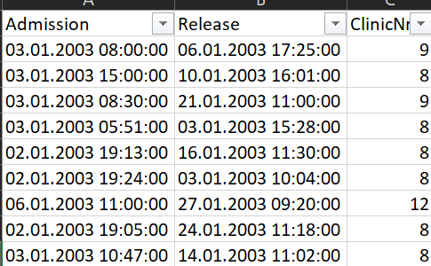
Raw Data
A medium-sized German hospital
400 beds approx.
October 2002 to June 2015
167,000 entries
13 clinics
Each clinic’s entries range from 300 to 35,000.

Slide 5
Data Processing
Removing all the missing values – 2% of all data
Separating data based on the Clinic Number

Slide 6
Data Transformation
Date of Admission*
Date of Release
Name of Clinic
Number of beds occupied per day in each clinic
Number of beds available per day in each clinic
Total Beds – Beds occupied = Beds available.
*Not taking the time into consideration only the date.

Slide 7
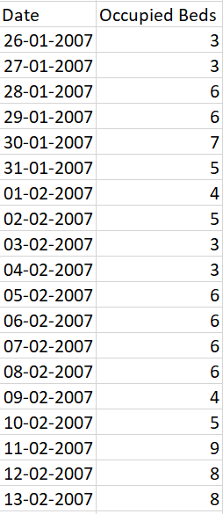
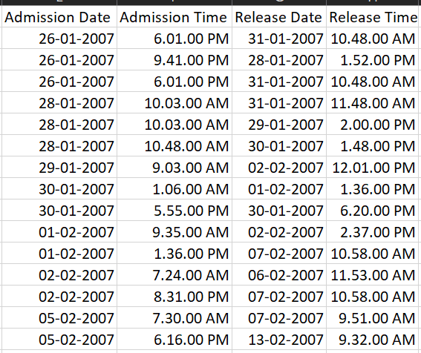
Data Transformation for clinic 5

Slide 8
Clinic 5
1,700 entries

Slide 9
Clinic 12
35,000 entries

Slide 10
Data Transformation cont.
Total Beds information is available about the whole hospital.
But don’t have information about each clinic

Slide 11
Thank you!

